Slide 1
Crime rates vs economic prosperity
Naveen Balachandran, Anjali Krishna, Alan Davila, & Kieran Singh

Slide 2
Motivations & questions
Does crime trend with economic conditions over time?
Can we use variables to predict trends?
When prosperity increases does crime decrease?
Does the data support what we intuitively think?
Why? Because we’re curious data analysts
Did we satisfy our curiosity?

Slide 3
Questions & data
Relationship between financial institutions and crime over time
What variables can we get data on
What we originally wanted
Crime rates
Proxy variables for measuring prosperity
Median income
Unemployment

Slide 4
Variables
Crime rates (theft)
FBI - Crime Data Explorer
Unemployment (U3)
Bureau of Labor Statistics
Median household income
Government Census

Slide 5
Data Cleanup, Exploration, & PROBLEMS
Lots of hunting
Lots of combining of data sets
Pivoting orientation (thanks Seth!)
Problems:
Finding the data that stretched far enough back in time
Change question and use proxies
State level

Slide 6

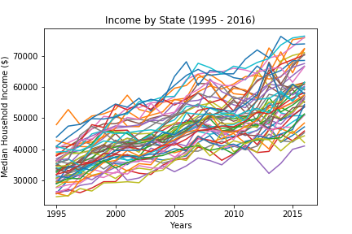
Income Trends
Income goes up over time

Slide 7
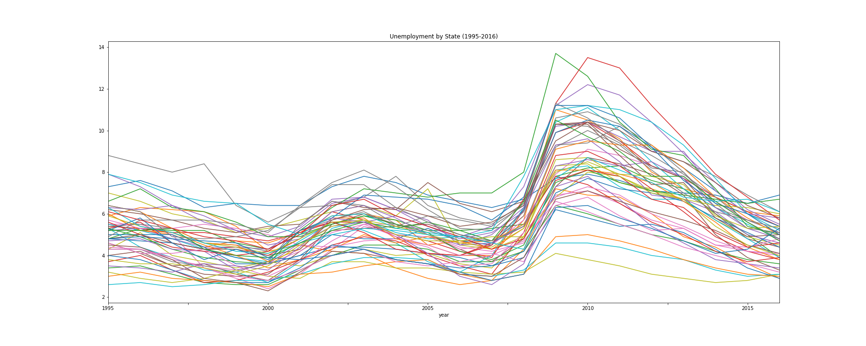
Unemployment Trends
Unemployment is cyclical and all states trend similarly

Slide 8
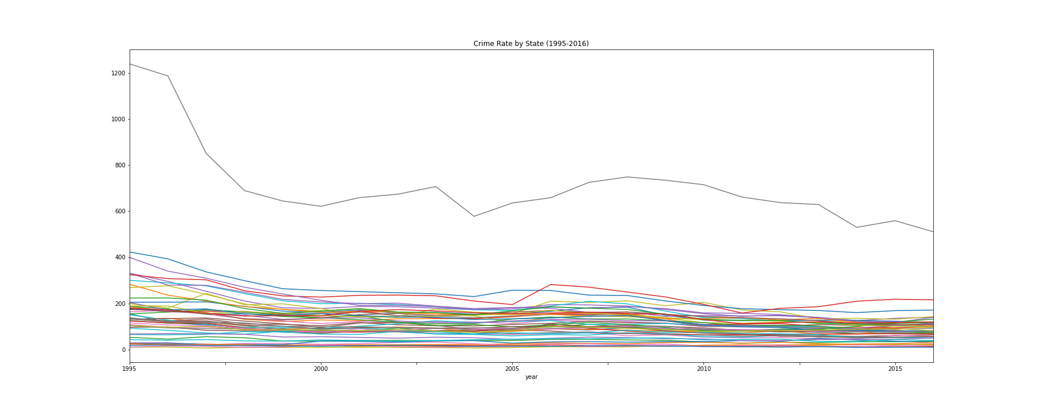
Crime trends
Flat, slight decreasing over time

Slide 9
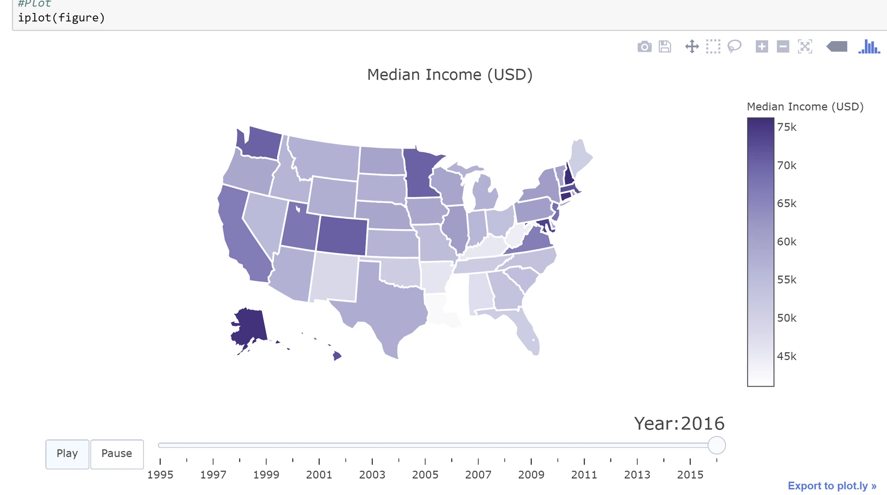

Slide 10
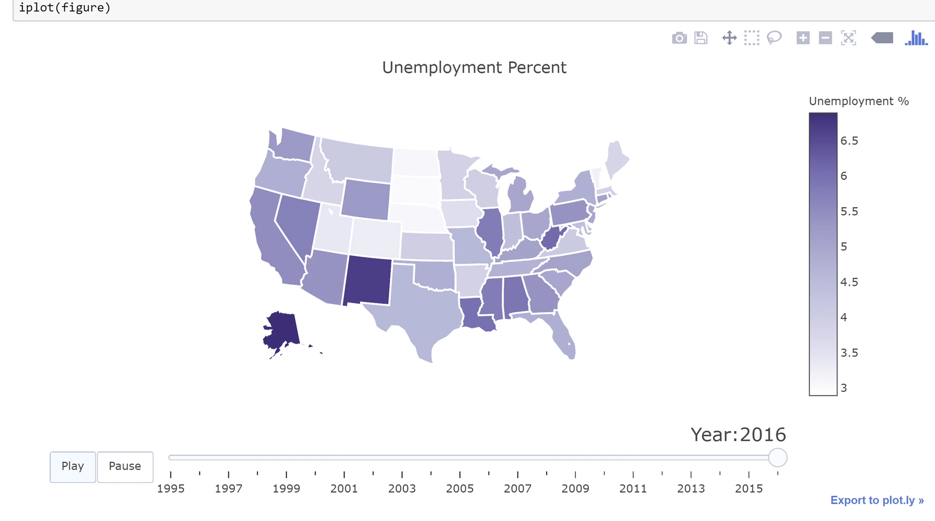

Slide 11
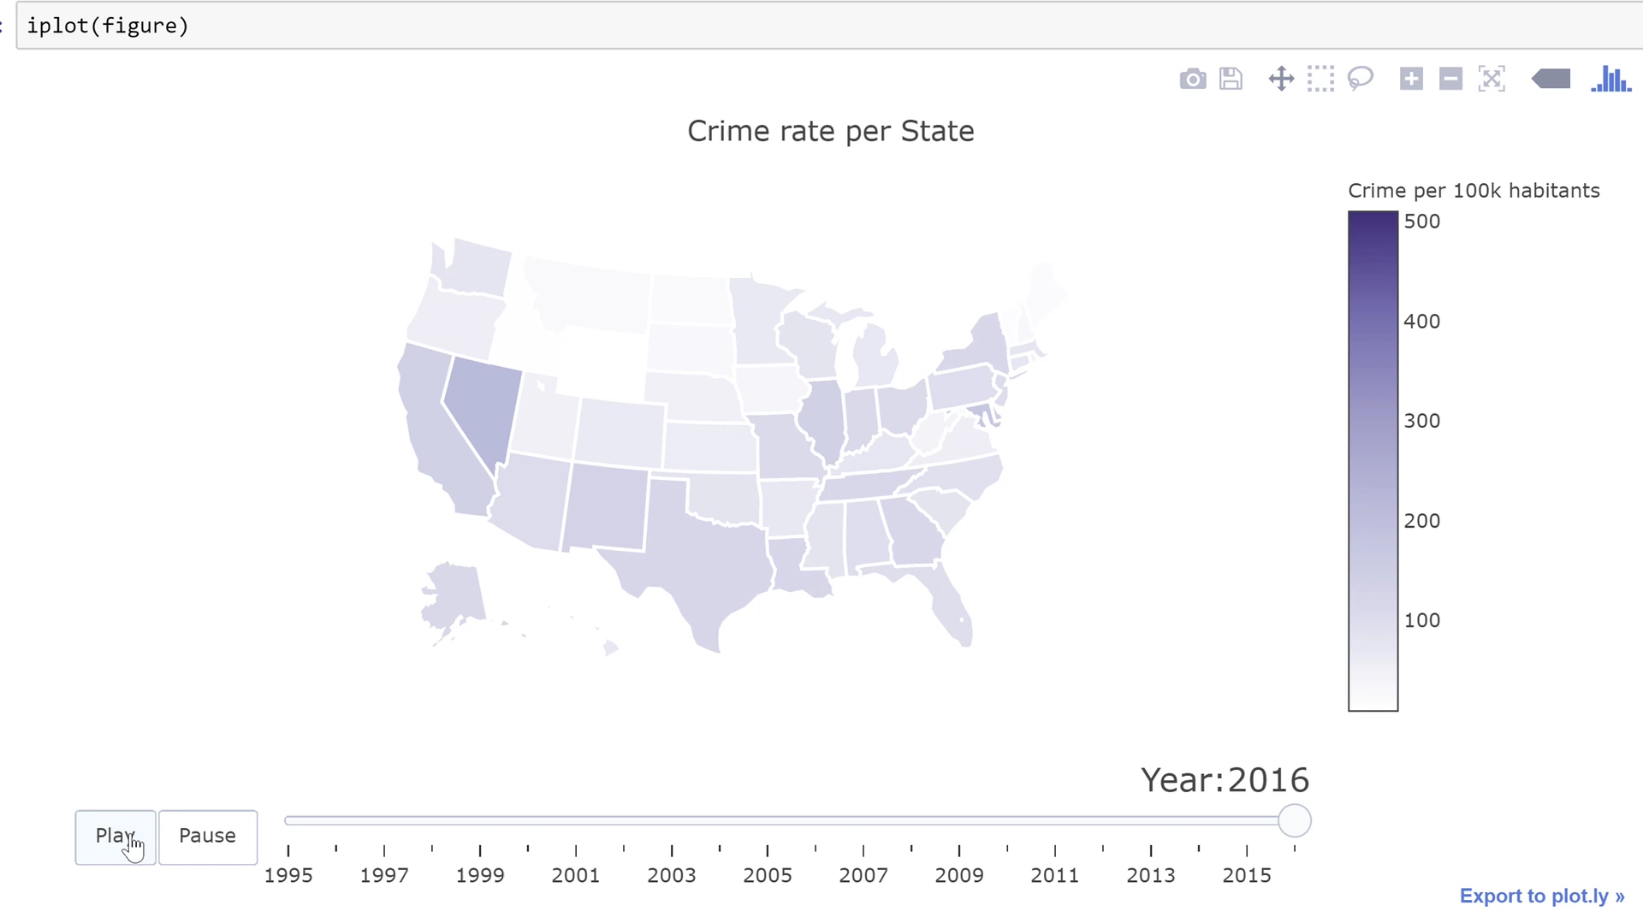

Slide 12
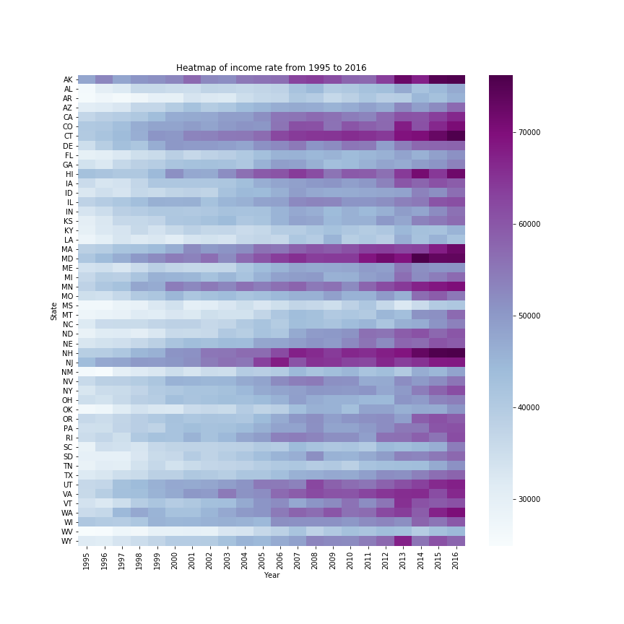

Slide 13
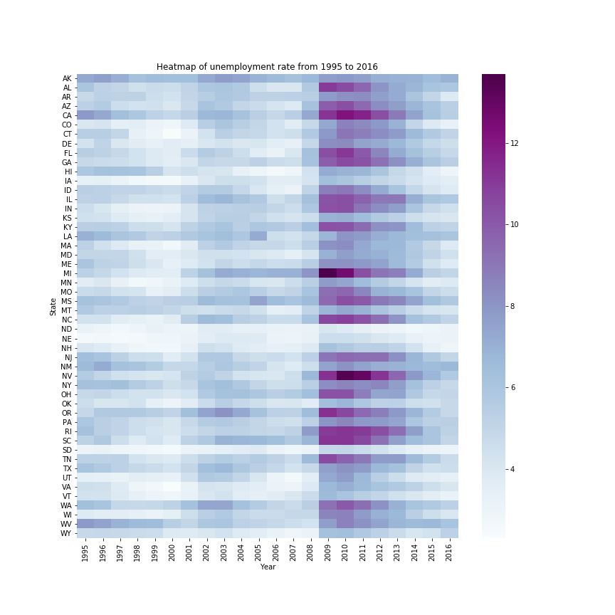

Slide 14
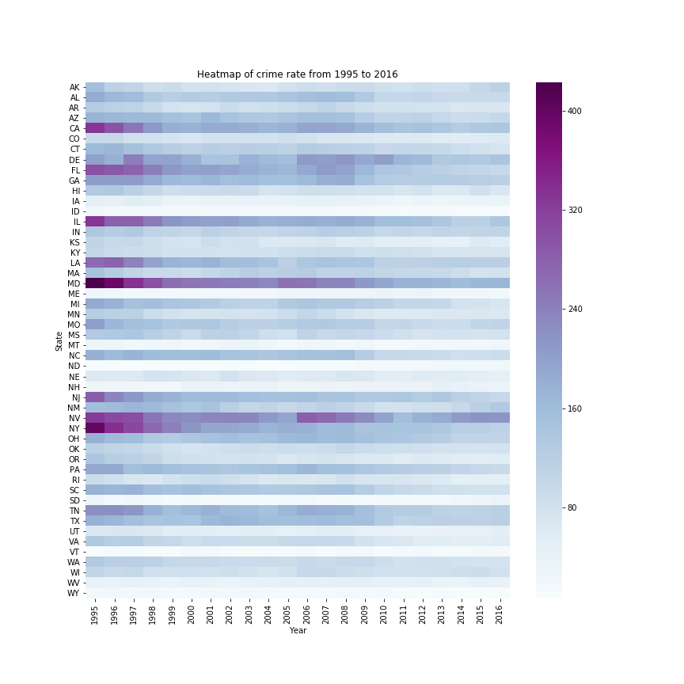

Slide 16
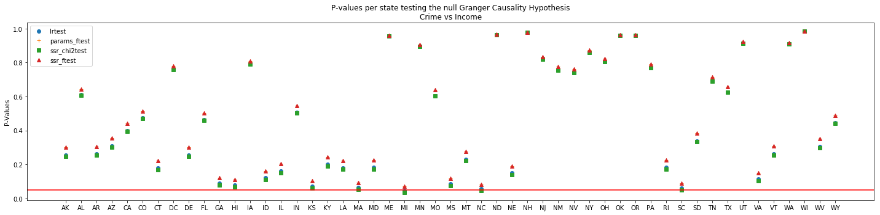

Statistical analysis crime vs income
The purpose of the follwoing analysis is to determine if the median income or unemployment time series information can be used to predict future crime rates. We will use the Granger Causality test in order to determine the predictive power of those two variables. The Granger Causality test is used by economist in order to compare two time series.

Slide 17
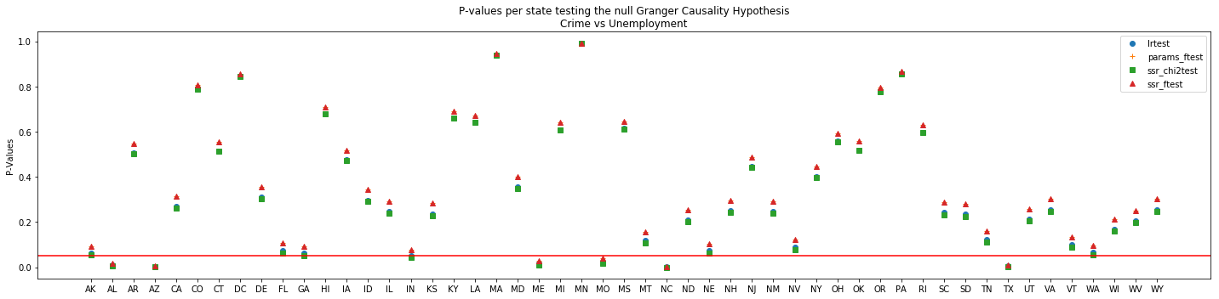
Statistical analysis crime vs unemployment
Conclusion:
None of the states shows Granger Causality when comparing crime vs median income.
A handfull of states showed Granger Causality when comparing crime vs unemployment. The majority did not
We can conclude that unemployment and median income are not good predictors of crime rate in most states of the United States when analyzing data form 1995 to 2016.

Slide 18
TWO MORE WEEKS?
Investigate other crime variables
01
Get data on the county or city level
02
Find data on our original question
03

Slide 19
Questions?

